Slide 1
Team Project: Mail Orders
By: Keshav Gurushankar, Devryan Singh, Can Huynh, Joseph Monge, Thinh Huynh

Slide 2
Roles
Keshav Gurushankar: Lead - putting it together and debug
Devryan Singh: File IO
Thinh Huynh: Hash Table
Can Huynh: Search
Joseph Monge: BST

Slide 3
Our goal
To design and come up with a program that sort and search for targeted mail
One of the search is by using hash methods that take the tracking number as a unique key and put it into a hash array.
Another feature of our program is that we used two Binary Search Tree to search for the targeted item. One tree uses the tracking number and the other one uses the priority order.

Slide 4
Data Structure Diagram
PriorityMail
TrackingMail
Mail:
-Address: address
-Date: date
-Type: type
String: tracking number
Address:
-address
-state
-country
-name
Type:
-priority
-normal
-economy
Date:
-int:day
-int: month
-int: year

Slide 5
Data Structure Diagram (cont)
BST
Main:
Hash
BinaryTree
LinkedList
BinaryNode
Queue
Mail: Priority & Tracking

Slide 6
Program Structure and UML Chart

Slide 7
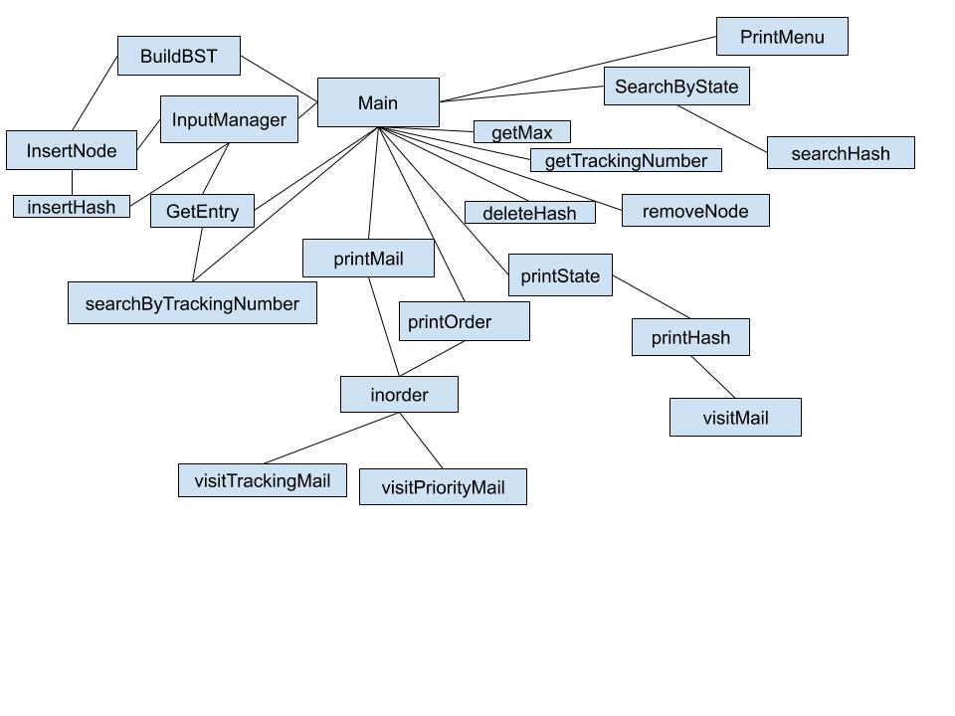
Program Structure

Slide 8
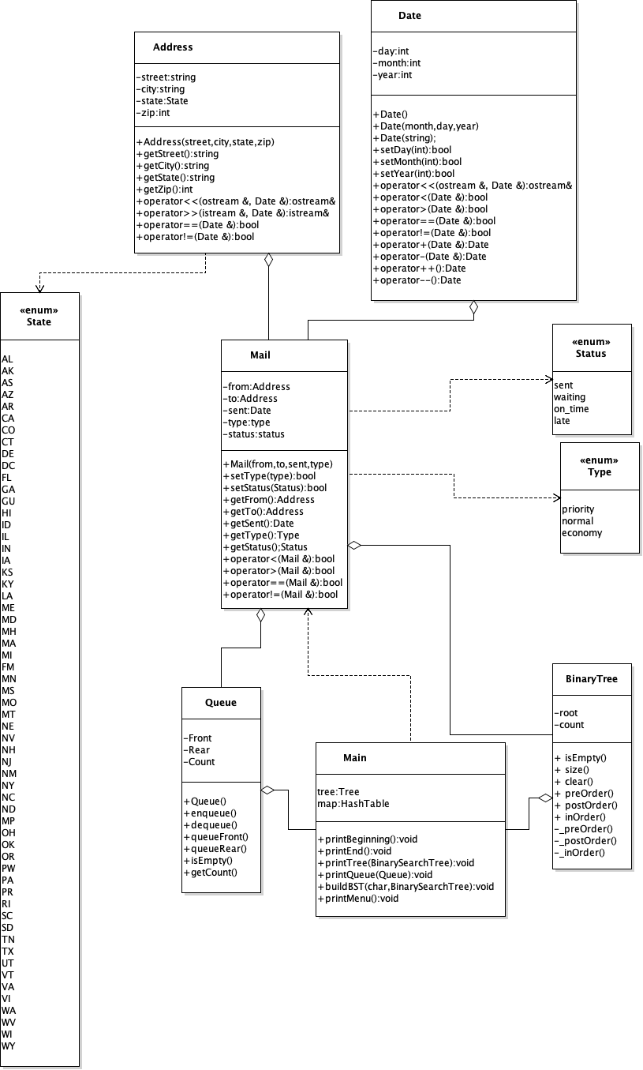
UML Chart

Slide 9
Hash

Slide 10
Hash
template <class ItemType>
int HashTable<ItemType>::getHashIndex(string input)
{
int index = 0;
int cube;
for (int i = 0; i < input.length(); i++)
{
cube = static_cast<int>(pow(input[i], 3.0));
index += cube;
}
if (index >= arraySize)
index = index % arraySize;
return index;
}

Slide 11
Data

Slide 12
Address.txt
ID Street City State Zip
0 44136 Minerva Green Nestor Alley South Ceciliamouth NE 45310
1 429 Kirlin Crest Kunze Spur East Brice WY 04949
2 5114 Renner Wall Weston Square East Jess NC 46494
3 41027 Schumm Manors Dorthy Camp Jenningsmouth UT 60458
4 831 Herman Drives Keara Island West Jarrettmouth IA 64134
5 3070 Wehner Neck Marcia Knoll East Amirhaven NC 62803
6 99524 Javier Villages Maxime Via Nellefurt TX 84372
7 42739 Wiza Summit Woodrow Stravenue Lake Kyleestad AK 97196
8 938 Regan Mountains Daugherty Haven New Autumnberg NC 39356
9 090 Keshawn Fields Macejkovic Ranch New Axelview UT 52621

Slide 13
Mail.txt
Mail ID From Address ID To Address ID Date Sent Type
0 45 30 10/3/2019 normal
1 29 55 10/3/2019 normal
2 19 88 11/6/2019 normal
3 74 24 11/3/2019 normal
4 75 62 11/3/2019 priority
5 82 80 10/7/2019 priority
6 11 87 10/5/2019 economy
7 35 88 10/7/2019 normal
8 42 90 11/3/2019 normal
9 1 50 10/2/2019 economy

Slide 14
Test (run the program!)

Slide 15
Input | Function
READ address mail | Load data from input files
PRINT | Print out the list of mail in order of which they need to be sent (from top)
SEARCH tracking_number | Search for a mail with specific tracking number
SEND n | Removes first n mails from the list
REMOVE tracking_number | Removes mail with id from list
INSERT | Guides through inserting a new mail (specify tracking number, but does a duplicate check)
CLEAR | Clear all data from database (prompt for confirmation!)
QUIT/EXIT/Q/E | Exit, and write output to out.txt

Slide 16
Q&A!

Slide 17
Thanks for Listening!

